Slide 1


Data Structure
Course Code : ENCS205
Dr Swati Gupta
Associate Professor, School of Engineering & Technology
K.R. Mangalam University
Unit 4 :Trees and Graphs
Notes:
New Courses replaced with New Programmes

Slide 2

INTRODUCTION TO GRAPHS
Session 52
Applications of Graph in Real World
Basic Introduction of Graph
Basic Terminology used in Graph
Representation of Graph
Notes:
New Courses replaced with New Programmes

Slide 3
RECAP
A threaded binary tree is a type of binary trees in which:
All left child pointers that are NULL (in Linked list representation) points to its in-order predecessor,
All right child pointers that are NULL (in Linked list representation) points to its in-order successor.
Notes:
New Courses replaced with New Programmes

Slide 4
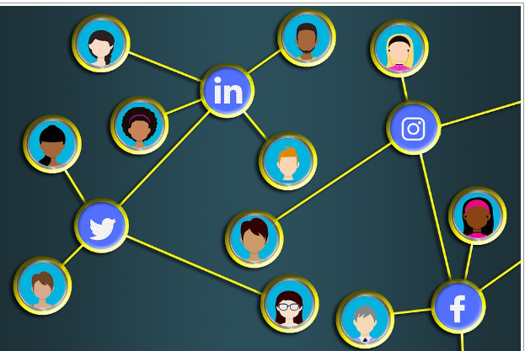
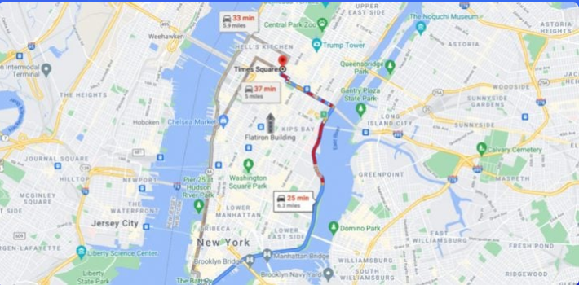
Applications of Graph in Real World
The social media networking sites like Linkedin and Facebook
Model transportation systems, to find the shortest or quickest routes between locations.
represent and analyze images and videos, such as tracking objects.
Notes:
New Courses replaced with New Programmes

Slide 5
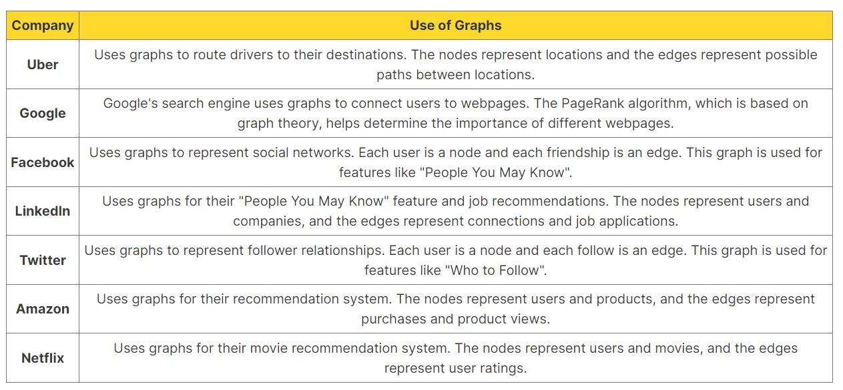
Applications of Graph in Real World
Notes:
New Courses replaced with New Programmes

Slide 6
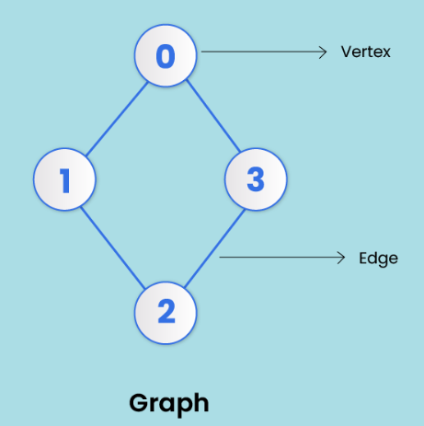
Basic Introduction of Graphs
A graph is a non-linear data structure made up of nodes or vertices and edges.
The edges connect any two nodes in the graph, and the nodes are also known as vertices.
Notes:
New Courses replaced with New Programmes

Slide 7
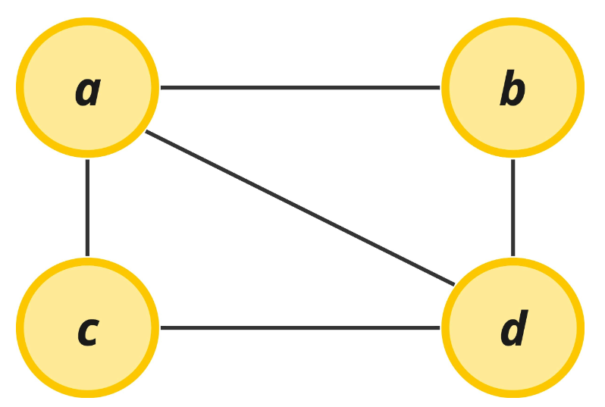
Basic Introduction of Graphs
You'll typically see mathematical notations representing graphs as shown …
G = (V, E)
V = {a,b,c,d}
E = {{a, b}, {a, c}, {a, d}, {b, d}, {c, d}}
Notes:
New Courses replaced with New Programmes

Slide 8
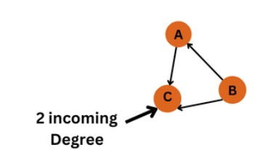
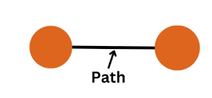
Basic Terminology in Graph Data Structure
Degree: The degree of a vertex is the number of edges incident to it
Path: A path in a graph is a sequence of edges that connects two vertices.
Notes:
New Courses replaced with New Programmes

Slide 9
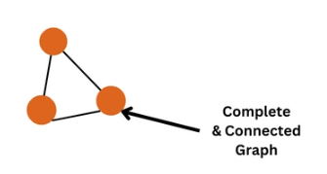
Basic Terminology in Graph Data Structure
Connected: A graph is said to be a connected graph if a path exists between every pair of vertices.
Complete: A graph is said to be a complete graph if there is an edge between every pair of vertices..
Notes:
New Courses replaced with New Programmes

Slide 10
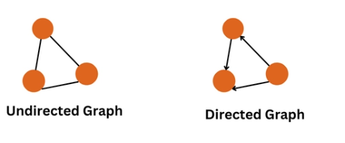
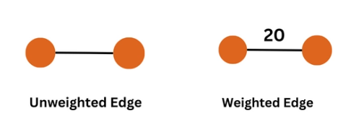
Basic Terminology in Graph Data Structure
Directed/Undirected: A graph is said to be directed if edges have a direction and undirected if edges do not.
Weighted/Unweighted: A graph is said to be weighted if edges have a value or weight associated with them and unweighted if they do not.
Notes:
New Courses replaced with New Programmes

Slide 11
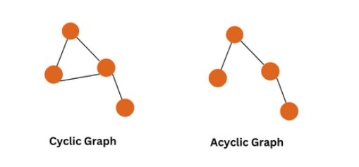
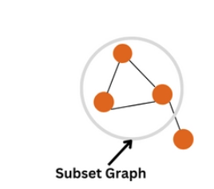
Basic Terminology in Graph Data Structure
Cyclic/Acyclic: A graph is cyclic if a path begins and ends at the same vertex and acyclic if there is no such path.
Subgraph: A subgraph of a graph is a graph that is a subset of the vertices and edges of the original graph.
Notes:
New Courses replaced with New Programmes

Slide 12
Representation of Graph
There are the two most common ways to represent a graph :
Adjacency Matrix
Adjacency List
Notes:
New Courses replaced with New Programmes

Slide 13
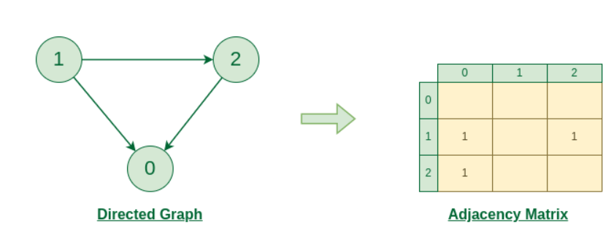
Adjacency Matrix : Directed Graph
Initially, the entire Matrix is ​​initialized to 0.
If there is an edge from source to destination, we insert 1 for that particular adjMat[destination].
Notes:
New Courses replaced with New Programmes

Slide 14
Adjacency Matrix : Directed Graph
Initially, the entire Matrix is ​​initialized to 0.
If there is an edge from source to destination, we insert 1 for that particular adjMat[destination].
Notes:
New Courses replaced with New Programmes

Slide 15

Representing a Graph using Adjacency Matrix
Creating a Structure
class Graph {
int numVertices;
vector<vector<int>> adjMatrix;
public:
Graph(int vertices) {
numVertices = vertices;
adjMatrix.resize(vertices, vector<int>(vertices, 0));
}
void addEdge(int src, int dest) {
adjMatrix[src][dest] = 1;
adjMatrix[dest][src] = 1; // For undirected graph
}
Acess the Compete Code Here :https://onlinegdb.com/c5yzfLsrKc

Slide 16
Adjacency List
The adjacency list is an array of linked lists where the array denotes the total vertices and each linked list denotes the vertices connected to a particular node.
In a linked list, the most important component is the pointer named ‘Head’ because this single pointer maintains the whole linked list.
Notes:
New Courses replaced with New Programmes

Slide 17
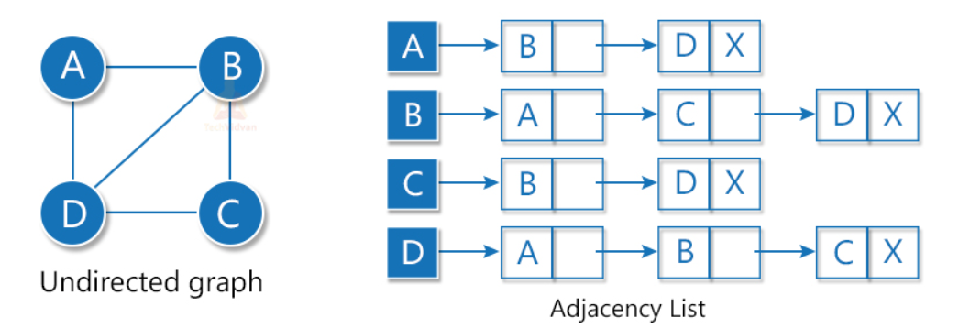
Adjacency List : Undirected Graph
For an undirected graph, we will link all the edges in the list that are connected to a node as shown:
Notes:
New Courses replaced with New Programmes

Slide 18
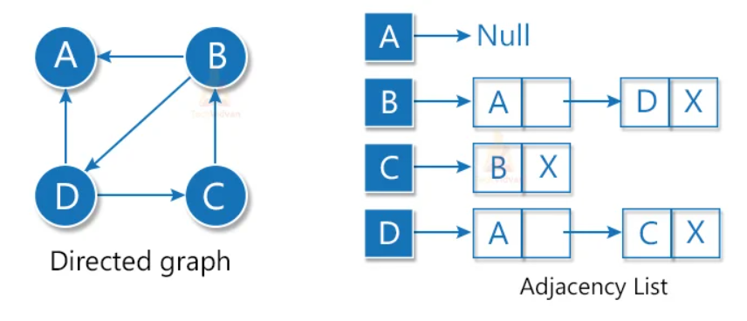
Adjacency List : Directed Graph
In a directed graph, we will link only the initial nodes in the list as shown:
Notes:
New Courses replaced with New Programmes

Slide 19
Representing a Graph using Adjacency List
Creating a Structure
class Graph {
int numVertices;
vector<list<int>> adjList;
public:
Graph(int vertices) {
numVertices = vertices;
adjList.resize(vertices);
}
void addEdge(int src, int dest) {
adjList[src].push_back(dest);
adjList[dest].push_back(src); // For undirected graph
}
Access the Complete Code Here :https://onlinegdb.com/b7z-u1TgN

Slide 20
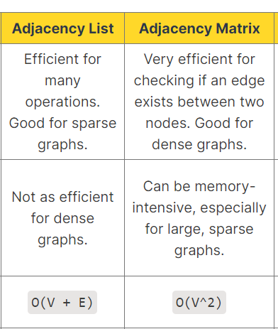
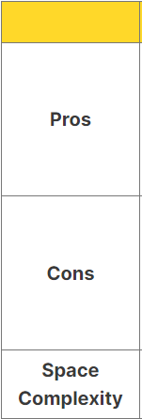
Summary
Notes:
New Courses replaced with New Programmes

Slide 21
REVIEW
A graph is a non-linear data structure made up of nodes or vertices and edges.
There are the two most common ways to represent a graph :
Adjacency Matrix
Adjacency List
Notes:
New Courses replaced with New Programmes

Slide 22
Test Your Knowledge
Q1 A person wants to visit some places. He starts from a vertex and then wants to visit every place connected to this vertex and so on. What algorithm he should use? a) Depth First Search b) Breadth First Search c) Trim’s algorithm d) Kruskal’s algorithm
Answer (B)
Q2 Which of the following is not an application of Breadth First Search? a) Finding shortest path between two nodes b) Finding bipartiteness of a graph c) GPS navigation system d) Path Finding
Answer (D)
Notes:
New Courses replaced with New Programmes

Slide 23
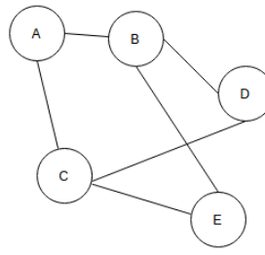
Test Your Knowledge
Q3 In BFS, how many times a node is visited? a) Once b) Twice c) Equivalent to number of indegree of the node d) Thrice
Answer (C)
Q4 For the given graph(G), which of the following statements is true?
a) G is a complete graph b) G is not a connected graph c) The vertex connectivity of the graph is 2 d) The edge connectivity of the graph is 1
Answer (C)
Notes:
New Courses replaced with New Programmes

Slide 24
Test Your Knowledge
Q5 Which of the following is true? a) A graph may contain no edges and many vertices b) A graph may contain many edges and no vertices c) A graph may contain no edges and no vertices d) A graph may contain no vertices and many edges
Answer (B)
Q6 If a Graph Structured Stack contains {1,2,3,4} {1,5,3,4} {1,6,7,4} and {8,9,7,4}, what would be the source and sink vertices of the DAC? a) Source – 1, 8 Sink – 7,4 b) Source – 1 Sink – 8,4 c) Source – 1, 8 Sink – 4 d) Source – 4, Sink – 1,8
Answer (C)
Notes:
New Courses replaced with New Programmes

Slide 25
References
https://www.boardinfinity.com/blog/graphs-in-data-structure/.
https://www.geeksforgeeks.org/what-is-graph-data-structure/
https://www.tutorialspoint.com/data_structures_algorithms/graph_data_structure.html.
https://www.simplilearn.com/tutorials/data-structure-tutorial/graphs-in-data-structure
https://www.geeksforgeeks.org/applications-of-graph-data-structure/
https://www.upgrad.com/blog/graphs-in-data-structure/
https://www.youtube.com/watch?v=4IZ80K72OXo
Notes:
New Courses replaced with New Programmes

Slide 26
THANK YOU

